Slide 1


MCQ-BASED EXAM
PLATFORM
GROUP-2
TEAM LEADER :
Arunima Biswas ( 22CS8014 )
TEAM MEMBERS :
S Sankeerth Reddy ( 22CS8011 )
Mohammed E. Safwam ( 22CS8012 )
W. D. Tharushi S. N. Dayarathne ( 22CS8013 )
Anusrita Karmakar ( 22CS8015 )
Akash Kumar Gayen ( 22CS8016 )
Telagareddy Sai Prasanna Kumar ( 22CS8017 )
Ambati Gurucharan ( 22CS8018 )
Guthikonda Vijay Venkat Reddy ( 22CS8019 )
Debidyuti Kar ( 22CS8020 )

Slide 2

OBJECTIVE:
To develop an online MCQ exam platform that facilitates instructors to upload question banks, grading policies, and answer keys, and enables students to take exams in a secure, structured manner.
KEY REQUIREMENTS:
Instructors: Upload questions, define grading schemes, shuffle policies.
Students: Take exams, receive instant results, and performance analytics.
CHALLENGES:
Scalability to handle multiple students.
Redundancy and robust performance.
Security in data storage and student authentication.

Slide 3

SYSTEM FEATURE OVERVIEW
CORE FEATURES :
User Login and Registration:
Secure login with passwords for students and instructors.
Question Bank Upload:
Instructors upload and update questions via .txt files.
Question Shuffling:
Randomized question order to prevent cheating.
Grading and Results:
Instant grading and feedback after exam completion.
Redundancy:
Automatic data backups to handle server failures.

Slide 4
Additional Features
Feature 1: Timer Based Questions
Description : Instructors can assign a timer for individual questions or the entire exam
Purpose : Increases exam integrity by restricting time per question or section
Feature 2: User Progress Tracking
Description : Real-time tracking for students to see how many questions are answered and how much time remains.
Benifit : Enhance time management and exam-taking efficiency.
Feature 3: Hints
Description : Instructors can provide optional hints for specific questions to assist students during the exam. These hints can be revealed either immediately or after a certain time has elapsed
Benifit : To offer guidance and support without compromising exam difficulty, helping students who may be struggling with particular questions while maintaining fairness.

Slide 5

OS Features and Technical Aspects
Multithreading:
Manages multiple students taking exams concurrently.
Improves server efficiency and reduces response time
Socket Programming:
Facilitates real-time data exchange between client (student) and server.
Manages exam submissions, question loading, and results display.
File Handling:
Involves parsing .txt files for question banks.
Storing student answers and logs in files or databases.
Simple encryption for databases .
Redundancy & Fault Tolerance:
Backup mechanisms to handle server failures, ensuring progress is saved periodically (e.g every 30 seconds).

Slide 6
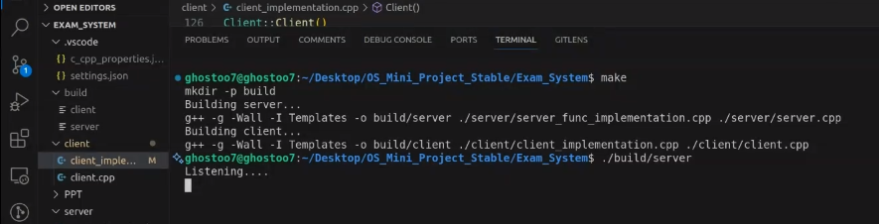
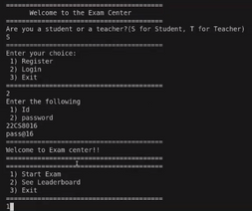
UI LAYOUT
The UI layout consists of two sections :
Instructor Dashboard:
Upload question bank files.
Define grading policies and question shuffling options.
Timer-based settings for exams.
Student Dashboard:
View available exams.
Exam interface with live timers, progress indicators (answered/unanswered questions).
Past Activity and Performance Reviews.

Slide 7

PROJECT BREAKDOWN
Frontend Development:
Design user-friendly interfaces for instructors and students.
Display exam layout with timers and progress indicators.
Backend Development:
Parse questions from .txt files and manage the database.
Implement APIs for question bank upload, timer, and grading policies.
Timer and Question Handling:
Integrate timers for individual questions or entire exams.
Auto-submit answers when time runs out.
Redundancy & Backup:
Ensure automatic backup of exam progress.
Implement fault tolerance to handle server failures.
Authentication:
Secure login and registration with password.
Role-based access for students and instructors.
Socket Programming:
Real-time data transfer between clients and server.
Support for multi-user interactions during exams.

Slide 8


THANK
YOU
team2Xosminiproject@gmail.com

